Slide 1
CS162 Operating Systems and Systems Programming Lecture 17 Performance Storage Devices, Queueing Theory
October 24, 2018
Prof. Ion Stoica
http://cs162.eecs.Berkeley.edu

Slide 2
Review: Basic Performance Concepts
Response Time or Latency: Time to perform an operation
Bandwidth or Throughput: Rate at which operations are performed (op/s)
Files: NB/s, Networks: Mb/s, Arithmetic: GFLOP/s
Start up or “Overhead”: time to initiate an operation
Most I/O operations are roughly linear in n bytes
Latency(n) = Overhead + n/Bandwidth

Slide 3
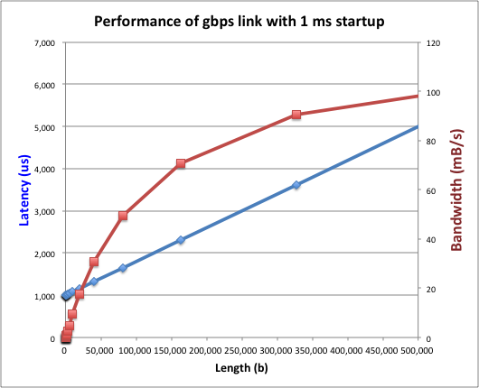
Example (Fast Network)
Consider a 1 Gb/s link (B = 125 MB/s)
With a startup cost S = 1 ms
Latency(n) = S + n/B
Bandwidth = n/(S + n/B) = B*n/(B*S + n) = B/(B*S/n + 1)

Slide 4
Example (Fast Network)
Consider a 1 Gb/s link (B = 125 MB/s)
With a startup cost S = 1 ms
Bandwidth = B/(B*S/n + 1)
half-power point occurs at n=S*B → Bandwidth = B/2

Slide 5
Example: at 10 ms startup (like Disk)
n = 1,250,000 bytes!

Slide 6
What Determines Peak BW for I/O ?
Bus Speed
PCI-X: 1064 MB/s = 133 MHz x 64 bit (per lane)
ULTRA WIDE SCSI: 40 MB/s
Serial Attached SCSI & Serial ATA & IEEE 1394 (firewire): 1.6 Gb/s full duplex (200 MB/s)
USB 3.0 – 5 Gb/s
Thunderbolt 3 – 40 Gb/s
Device Transfer Bandwidth
Rotational speed of disk
Write / Read rate of NAND flash
Signaling rate of network link
Whatever is the bottleneck in the path…

Slide 7
Storage Devices
Magnetic disks
Storage that rarely becomes corrupted
Large capacity at low cost
Block level random access (except for SMR – later!)
Slow performance for random access
Better performance for sequential access
Flash memory
Storage that rarely becomes corrupted
Capacity at intermediate cost (5-20x disk)
Block level random access
Good performance for reads; worse for random writes
Erasure requirement in large blocks
Wear patterns issue

Slide 8
The Amazing Magnetic Disk
Unit of Transfer: Sector
Ring of sectors form a track
Stack of tracks form a cylinder
Heads position on cylinders
Disk Tracks ~ 1µm (micron) wide
Wavelength of light is ~ 0.5µm
Resolution of human eye: 50µm
100K tracks on a typical 2.5” disk
Separated by unused guard regions
Reduces likelihood neighboring tracks are corrupted during writes (still a small non-zero chance)

Slide 9
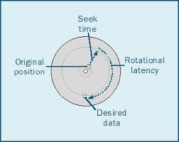
Review: Magnetic Disks
Track
Cylinders: all the tracks under the head at a given point on all surface
Read/write data is a three-stage process:
Seek time: position the head/arm over the proper track
Rotational latency: wait for desired sector to rotate under r/w head
Transfer time: transfer a block of bits (sector) under r/w head
Sector
Head
Cylinder
Platter
Seek time = 4-8ms
One rotation = 1-2ms (3600-7200 RPM)

Slide 10
Review: Magnetic Disks
Track
Cylinders: all the tracks under the head at a given point on all surface
Read/write data is a three-stage process:
Seek time: position the head/arm over the proper track
Rotational latency: wait for desired sector to rotate under r/w head
Transfer time: transfer a block of bits (sector) under r/w head
Sector
Head
Cylinder
Platter
Disk Latency = Queueing Time + Controller time +
Seek Time + Rotation Time + Xfer Time
Software
Queue
(Device Driver)
Hardware
Controller
Media Time
(Seek+Rot+Xfer)
Request
Result

Slide 11
Disk Performance Example
Assumptions:
Ignoring queuing and controller times for now
Avg seek time of 5ms,
7200RPM ⇒ Time for rotation: 60000 (ms/minute) / 7200(rev/min) ~= 8ms
Transfer rate of 4MByte/s, sector size of 1 Kbyte ⇒ 1024 bytes/4×10⁶ (bytes/s) = 256 × 10⁻⁶ sec ≅ .26 ms
Read sector from random place on disk:
Seek (5ms) + Rot. Delay (4ms) + Transfer (0.26ms)
Approx 10ms to fetch/put data: 100 KByte/sec
Read sector from random place in same cylinder:
Rot. Delay (4ms) + Transfer (0.26ms)
Approx 5ms to fetch/put data: 200 KByte/sec
Read next sector on same track:
Transfer (0.26ms): 4 MByte/sec
Key to using disk effectively (especially for file systems) is to minimize seek and rotational delays

Slide 12
(Lots of) Intelligence in the Controller
Sectors contain sophisticated error correcting codes
Disk head magnet has a field wider than track
Hide corruptions due to neighboring track writes
Sector sparing
Remap bad sectors transparently to spare sectors on the same surface
Slip sparing
Remap all sectors (when there is a bad sector) to preserve sequential behavior
Track skewing
Sector numbers offset from one track to the next, to allow for disk head movement for sequential ops
…

Slide 13
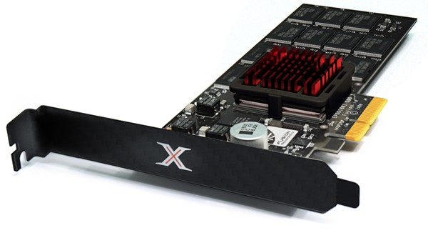
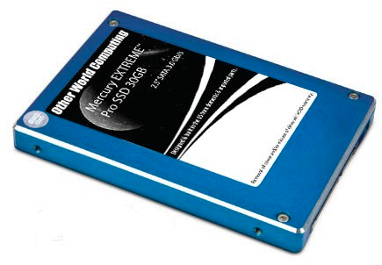
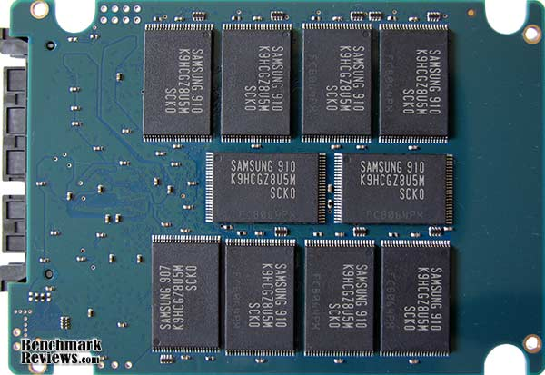
Solid State Disks (SSDs)
1995 – Replace rotating magnetic media with non-volatile memory (battery backed DRAM)
2009 – Use NAND Multi-Level Cell (2 or 3-bit/cell) flash memory
Sector (4 KB page) addressable, but stores 4-64 “pages” per memory block
Trapped electrons distinguish between 1 and 0
No moving parts (no rotate/seek motors)
Eliminates seek and rotational delay (0.1-0.2ms access time)
Very low power and lightweight
Limited “write cycles”
Rapid advances in capacity and cost ever since!

Slide 14
SSD Architecture – Reads
NAND
NAND
NAND
NAND
NAND
NAND
NAND
NAND
Host
Buffer
Manager
(software
Queue)
Flash
Memory
Controller
NAND
NAND
NAND
NAND
SATA
NAND
NAND
NAND
NAND
NAND
NAND
NAND
NAND
DRAM
NAND
NAND
NAND
NAND
NAND
NAND
Read 4 KB Page: ~25 usec
No seek or rotational latency
Transfer time: transfer a 4KB page
SATA: 300-600MB/s => ~4 x10³ b / 400 x 10⁶ bps => 10 us
Latency = Queuing Time + Controller time + Xfer Time
Highest Bandwidth: Sequential OR Random reads
NAND
NAND
NAND
NAND
NAND
NAND

Slide 15
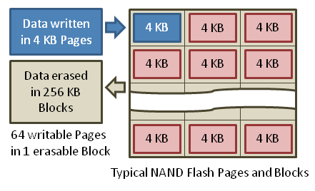
SSD Architecture – Writes
Writing data is complex! (~200μs – 1.7ms )
Can only write empty pages in a block
Erasing a block takes ~1.5ms
Controller maintains pool of empty blocks by coalescing used pages (read, erase, write), also reserves some % of capacity
Rule of thumb: writes 10x reads, erasure 10x writes
https://en.wikipedia.org/wiki/Solid-state_drive

Slide 16
Amusing calculation: is a full Kindle heavier than an empty one?
Actually, “Yes”, but not by much
Flash works by trapping electrons:
So, erased state lower energy than written state
Assuming that:
Kindle has 4GB flash
½ of all bits in full Kindle are in high-energy state
High-energy state about 10⁻¹⁵ joules higher
Then: Full Kindle is 1 attogram (10⁻¹⁸gram) heavier (Using E = mc²)
Of course, this is less than most sensitive scale can measure (it can measure 10⁻⁹ grams)
Of course, this weight difference overwhelmed by battery discharge, weight from getting warm, ….
According to John Kubiatowicz (New York Times, Oct 24, 2011)

Slide 17
SSD Summary
Pros (vs. hard disk drives):
Low latency, high throughput (eliminate seek/rotational delay)
No moving parts:
Very light weight, low power, silent, very shock insensitive
Read at memory speeds (limited by controller and I/O bus)
Cons
Small storage (0.1-0.5x disk), expensive (3-20x disk)
Hybrid alternative: combine small SSD with large HDD

Slide 18
SSD Summary
Pros (vs. hard disk drives):
Low latency, high throughput (eliminate seek/rotational delay)
No moving parts:
Very light weight, low power, silent, very shock insensitive
Read at memory speeds (limited by controller and I/O bus)
Cons
Small storage (0.1-0.5x disk), expensive (3-20x disk)
Hybrid alternative: combine small SSD with large HDD
Asymmetric block write performance: read pg/erase/write pg
Controller garbage collection (GC) algorithms have major effect on performance
Limited drive lifetime
1-10K writes/page for MLC NAND
Avg failure rate is 6 years, life expectancy is 9–11 years
These are changing rapidly!
No longer true!

Slide 19

Seagate Enterprise
10 TB (2016)
7 platters, 14 heads
7200 RPMs
6 Gbps SATA /12Gbps SAS interface
220MB/s transfer rate, cache size: 256MB
Helium filled: reduce friction and power usage
Price: $500 ($0.05/GB)
IBM Personal Computer/AT (1986)
30 MB hard disk
30-40ms seek time
0.7-1 MB/s (est.)
Price: $500 ($17K/GB, 340,000x more expensive !!)

Slide 20

Largest SSDs
60TB (2016)
Dual port: 16Gbs
Seq reads: 1.5GB/s
Seq writes: 1GB/s
Random Read Ops (IOPS): 150K
Price: ~ $20K ($0.33/GB)

Slide 21
I/O Performance
300
Response
Time (ms)
Controller
User
Thread
I/O
device
200
Queue
[OS Paths]
100
Response Time = Queue + I/O device service time
0
Performance of I/O subsystem
Metrics: Response Time, Throughput
Effective BW per op = transfer size / response time
EffBW(n) = n / (S + n/B) = B / (1 + SB/n )
0%
100%
Throughput (Utilization)
(% total BW)
# of ops
time per op
Fixed overhead

Slide 22
I/O Performance
300
Response
Time (ms)
Controller
User
Thread
I/O
device
200
Queue
[OS Paths]
100
Response Time = Queue + I/O device service time
0
Performance of I/O subsystem
Metrics: Response Time, Throughput
Effective BW per op = transfer size / response time
EffBW(n) = n / (S + n/B) = B / (1 + SB/n )
Contributing factors to latency:
Software paths (can be loosely modeled by a queue)
Hardware controller
I/O device service time
Queuing behavior:
Can lead to big increases of latency as utilization increases
Solutions?
0%
100%
Throughput (Utilization)
(% total BW)

Slide 23
A Simple Deterministic World
arrivals
Queue
Server
departures
T_{Q}
T_{S}
T_{A}
T_{A}
T_{A}
T_{q}
T_{S}
Assume requests arrive at regular intervals, take a fixed time to process, with plenty of time between …
Service rate (μ = 1/T_{S}) - operations per sec
Arrival rate: (λ = 1/T_{A}) - requests per second
Utilization: U = λ/μ , where λ < μ
Average rate is the complete story

Slide 24
A Ideal Linear World
Saturation
1
1
Delivered Throughput
Delivered Throughput
Empty Queue
Unbounded
0
1
0
1
Offered Load (T_{S}/T_{A})
Offered Load (T_{S}/T_{A})
Queue delay
Queue delay
time
time
What does the queue wait time look like?
Grows unbounded at a rate ~ (T_{s}/T_{A}) till request rate subsides

Slide 25
A Bursty World
arrivals
Queue
Server
departures
T_{Q}
T_{S}
Arrivals
Q depth
Server
Requests arrive in a burst, must queue up till served
Same average arrival time, but almost all of the requests experience large queue delays
Even though average utilization is low

Slide 26
So how do we model the burstiness of arrival?
Elegant mathematical framework if you start with exponential distribution
Probability density function of a continuous random variable with a mean of 1/λ
f(x) = λe^{-λx}
“Memoryless”
Likelihood of an event occurring is independent of how long we’ve been waiting
mean arrival interval (1/λ)
Lots of short arrival intervals (i.e., high instantaneous rate)
Few long gaps (i.e., low instantaneous rate)
x (λ)

Slide 27
Background: General Use of Random Distributions
Server spends variable time (T) with customers
Mean (Average) m = Σp(T)×T
Variance (stddev²) σ² = Σp(T)×(T-m)² = Σp(T)×T²-m²
Squared coefficient of variance: C = σ²/m² Aggregate description of the distribution
Important values of C:
No variance or deterministic ⇒ C=0
“Memoryless” or exponential ⇒ C=1
Past tells nothing about future
Poisson process – purely or completely random process
Many complex systems (or aggregates) are well described as memoryless
Disk response times C ≈ 1.5 (majority seeks < average)
Mean
(m)
σ
Distribution
of service times
mean
Memoryless

Slide 28
Administrivia
Midterm 2 coming up on Mon 10/29 5:00-6:30PM
All topics up to and including Lecture 17
Focus will be on Lectures 11 – 17 and associated readings
Projects 1 and 2
Homework 0 – 2
Closed book
2 pages hand-written notes both sides

Slide 29
break

Slide 30
Introduction to Queuing Theory
Controller
Arrivals
Disk
Departures
Queue
Queuing System
What about queuing time??
Let’s apply some queuing theory
Queuing Theory applies to long term, steady state behavior ⇒ Arrival rate = Departure rate
Arrivals characterized by some probabilistic distribution
Departures characterized by some probabilistic distribution
Notes:
Old and New Testament by Kleirock
Regret skipping as grad student

Slide 31
Little’s Law
N
arrivals
departures
λ
L
In any stable system
Average arrival rate = Average departure rate
The average number of jobs/tasks in the system (N) is equal to arrival time / throughput (λ) times the response time (L)
N (jobs) = λ (jobs/s) x L (s)
Regardless of structure, bursts of requests, variation in service
Instantaneous variations, but it washes out in the average
Overall, requests match departures

Slide 32
Example
L = 5
λ = 1
L = 5
N = 5 jobs
Jobs
0
1
2
3
4
5
6
7
8
9
10
11
12
13
14
15
16
time
A: N = λ x L
E.g., N = λ x L = 5

Slide 33
Little’s Theorem: Proof Sketch
N
arrivals
departures
λ
Job i
L(i) = response time of job i
N(t) = number of jobs in system
at time t
L
N(t)
time
L(1)
T

Slide 34
Little’s Theorem: Proof Sketch
N
arrivals
departures
λ
Job i
L(i) = response time of job i
N(t) = number of jobs in system
at time t
L
N(t)
time
T
What is the system occupancy, i.e., average
number of jobs in the system?

Slide 35
Little’s Theorem: Proof Sketch
N
arrivals
departures
λ
Job i
L(i) = response time of job i
N(t) = number of jobs in system
at time t
S(i) = L(i) * 1 = L(i)
L
S(k)
N(t)
S(2)
S(1)
time
T
S = S(1) + S(2) + … + S(k) = L(1) + L(2) + … + L(k)

Slide 36
Little’s Theorem: Proof Sketch
N
arrivals
departures
λ
Job i
L(i) = response time of job i
N(t) = number of jobs in system
at time t
S(i) = L(i) * 1 = L(i)
L
N(t)
S= area
time
T
Average occupancy (N_{avg}) = S/T

Slide 37
Little’s Theorem: Proof Sketch
N
arrivals
departures
λ
Job i
L(i) = response time of job i
N(t) = number of jobs in system
at time t
S(i) = L(i) * 1 = L(i)
L
S(k)
N(t)
S(2)
S(1)
time
T
Navg = S/T = (L(1) + … + L(k))/T

Slide 38
Little’s Theorem: Proof Sketch
N
arrivals
departures
λ
Job i
L(i) = response time of job i
N(t) = number of jobs in system
at time t
S(i) = L(i) * 1 = L(i)
L
S(k)
N(t)
S(2)
S(1)
time
T
N_{avg} = (L(1) + … + L(k))/T = (N_{total}/T)*(L(1) + … + L(k))/N_{total}

Slide 39
Little’s Theorem: Proof Sketch
N
arrivals
departures
λ
Job i
L(i) = response time of job i
N(t) = number of jobs in system
at time t
S(i) = L(i) * 1 = L(i)
L
S(k)
N(t)
S(2)
S(1)
time
T
N_{avg} = (N_{total}/T)*(L(1) + … + L(k))/N_{total} = λ_{avg} × L_{avg}

Slide 40
Little’s Theorem: Proof Sketch
N
arrivals
departures
λ
Job i
L(i) = response time of job i
N(t) = number of jobs in system
at time t
S(i) = L(i) * 1 = L(i)
L
S(k)
N(t)
S(2)
S(1)
time
T
N_{avg} = λ_{avg} × L_{avg}

Slide 41
A Little Queuing Theory: Some Results (1/2)
Assumptions:
System in equilibrium; No limit to the queue
Time between successive arrivals is random and memoryless
Parameters that describe our system:
λ: mean number of arriving customers/second
T_{ser}: mean time to service a customer (“m”)
C: squared coefficient of variance = σ²/m²
μ: service rate = 1/T_{ser}
u: server utilization (0≤u≤1): u = λ/μ = λ × T_{ser}
Parameters we wish to compute:
T_{q}: Time spent in queue
L_{q}: Length of queue = λ × T_{q} (by Little’s law)
Queue
Server
Arrival Rate
λ
Service Rate
μ=1/T_{ser}

Slide 42
A Little Queuing Theory: Some Results (2/2)
Queue
Server
Arrival Rate
λ
Service Rate
μ=1/T_{ser}
Parameters that describe our system:
λ: mean number of arriving customers/second λ= 1/T_{A}
T_{ser}: mean time to service a customer (“m”)
C: squared coefficient of variance = σ²/m²
μ: service rate = 1/T_{ser}
u: server utilization (0≤u≤1): u = λ/μ = λ × T_{ser}
Parameters we wish to compute:
T_{q}: Time spent in queue
L_{q}: Length of queue = λ × T_{q} (by Little’s law)
Results (M: Poisson arrival process, 1 server):
Memoryless service time distribution (C = 1): Called an M/M/1 queue
T_{q} = T_{ser} x u/(1 – u)
General service time distribution (no restrictions): Called an M/G/1 queue
T_{q} = T_{ser} x ½(1+C) x u/(1 – u))

Slide 43
A Little Queuing Theory: An Example (1/2)
Example Usage Statistics:
User requests 10 x 8KB disk I/Os per second
Requests & service exponentially distributed (C=1.0)
Avg. service = 20 ms (From controller + seek + rotation + transfer)
Questions:
How utilized is the disk (server utilization)? Ans:, u = λT_{ser}
What is the average time spent in the queue? Ans: T_{q}
What is the number of requests in the queue? Ans: L_{q}
What is the avg response time for disk request? Ans: T_{sys} = T_{q} + T_{ser}

Slide 44
A Little Queuing Theory: An Example (2/2)
Questions:
How utilized is the disk (server utilization)? Ans:, u = λT_{ser}
What is the average time spent in the queue? Ans: T_{q}
What is the number of requests in the queue? Ans: L_{q}
What is the avg response time for disk request? Ans: T_{sys} = T_{q} + T_{ser}
Computation:
λ (avg # arriving customers/s) = 10/s
T_{ser} (avg time to service customer) = 20 ms (0.02s)
u (server utilization) = λ x T_{ser}= 10/s x .02s = 0.2
T_{q} (avg time/customer in queue) = T_{ser} x u/(1 – u) = 20 x 0.2/(1-0.2) = 20 x 0.25 = 5 ms (0 .005s)
L_{q} (avg length of queue) = λ x T_{q}=10/s x .005s = 0.05s
T_{sys} (avg time/customer in system) =T_{q} + T_{ser}= 25 ms

Slide 45
Queuing Theory Resources
Resources page contains Queueing Theory Resources (under Readings):
Scanned pages from Patterson and Hennessy book that gives further discussion and simple proof for general equation: https://cs162.eecs.berkeley.edu/static/readings/patterson_queue.pdf
A complete website full of resources: http://web2.uwindsor.ca/math/hlynka/qonline.html
Some previous midterms with queueing theory questions
Assume that Queueing Theory is fair game for Midterm III

Slide 46
Summary
Disk Performance:
Queuing time + Controller + Seek + Rotational + Transfer
Rotational latency: on average ½ rotation
Transfer time: spec of disk depends on rotation speed and bit storage density
Devices have complex interaction and performance characteristics
Response time (Latency) = Queue + Overhead + Transfer
Effective BW = BW * T/(S+T)
HDD: Queuing time + controller + seek + rotation + transfer
SDD: Queuing time + controller + transfer (erasure & wear)
Systems (e.g., file system) designed to optimize performance and reliability
Relative to performance characteristics of underlying device
Bursts & High Utilization introduce queuing delays
Queuing Latency:
M/M/1 and M/G/1 queues: simplest to analyze
As utilization approaches 100%, latency → ∞
T_{q} = T_{ser} x ½(1+C) x u/(1 – u))

Slide 47
Optimize I/O Performance
300
Response
Time (ms)
Controller
User
Thread
I/O
device
200
Queue
[OS Paths]
100
Response Time = Queue + I/O device service time
How to improve performance?
Make everything faster ☺
More decoupled (Parallelism) systems
Do other useful work while waiting
Multiple independent buses or controllers
Optimize the bottleneck to increase service rate
Use the queue to optimize the service
Queues absorb bursts and smooth the flow
Add admission control (finite queues)
Limits delays, but may introduce unfairness and livelock
0
0%
100%
Throughput (Utilization)
(% total BW)

Slide 48
When is Disk Performance Highest?
When there are big sequential reads, or
When there is so much work to do that they can be piggy backed (reordering queues—one moment)
OK to be inefficient when things are mostly idle
Bursts are both a threat and an opportunity
<your idea for optimization goes here>
Waste space for speed?
Other techniques:
Reduce overhead through user level drivers
Reduce the impact of I/O delays by doing other useful work in the meantime

